Slide 1
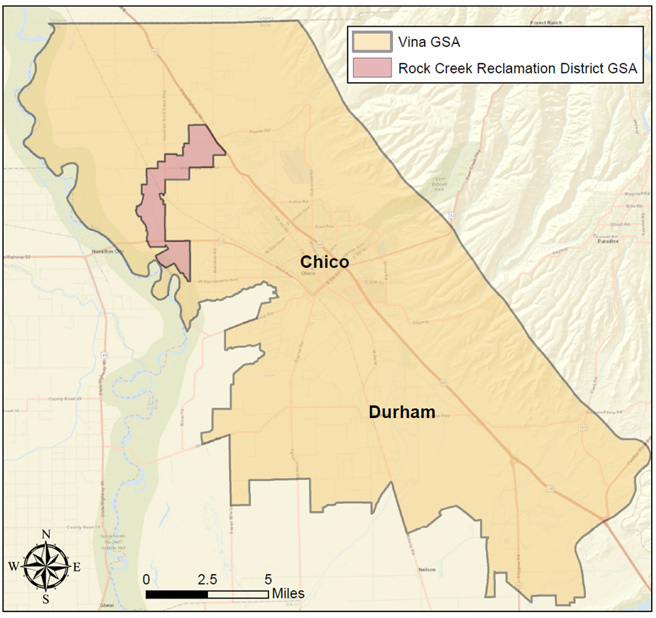
Projects and Management Actions
Vina Groundwater Sustainability Agency
March 10, 2021

Slide 2
Projects and Management Actions
Items 6.1.2.1 and 6.1.2.2
Status of Projects and Management Actions
Discussion of Legal Implications
Discussion and possible direction from the Board

Slide 3
Projects and Management Actions
About
A required element of Groundwater Sustainability Plans
Comprise the efforts that will achieve the sustainability goals (Measurable Objectives) established in the Vina GSP
PMAs are intended to achieve Measurable Objectives within the basin

Slide 4
Projects and Management Actions
About
Can include regulatory and non-regulatory actions
Vina GSA Board has ample authority to take certain actions
Vina GSA Board may accept projects or actions proposed by project proponents (e.g., Member Agencies, water purveyors, associations)
Any PMA must meet criteria prescribed in the GSP regulations

Slide 5
Projects and Management Actions
Requirements
The status of the PMA, including a time-table for expected initiation and completion, and the accrual of expected benefits.
An explanation of the benefits that are expected to be realized from the PMA, and how those benefits will be evaluated.
An explanation of how the PMA will be accomplished.
A description of the legal authority to carry out the PMA and the basis for that authority within the Agency.
A description of the estimated cost of the PMA and the plans to meet those costs.

Slide 6
Projects and Management Actions
Requirements
A description of the measurable objective that is expected to benefit from the PMA (ex. groundwater levels, groundwater storage etc.).
A description whether the PMA will be used to meet interim milestones, the exceedance of minimum thresholds, or where undesirable results have occurred or are imminent.
A description of the circumstances under which the PMAs will be implemented, the criteria that would trigger implementation and termination
A summary of the permitting and regulatory process required for each project and management action.

Slide 7
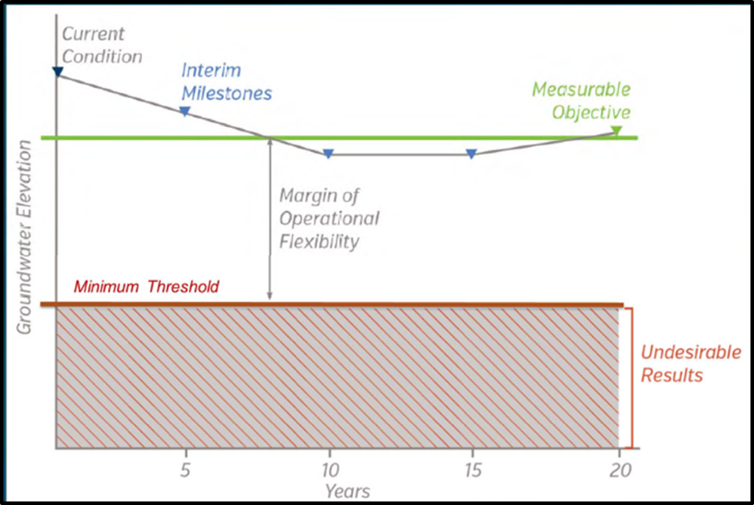
Projects and Management Actions
Implementation
Do not have to be implemented on January 31, 2022
Will require funding for implementation (cost/benefit)
20 Year Implementation Horizon - 5-Year Progress Reports

Slide 8
Projects and Management Actions
Solicitation
General Discussion and Brainstorming by the Stakeholder Advisory Committee
Solicitation form on the Vina GSA webpage - captures most of the Project and Management Action requirements
Project sponsors can be:
Local agencies
Water purveyors
Member Agencies
Vina GSA
Rock Creek Reclamation District GSA
Seeking a wide range of PMAs

Slide 9
Projects and Management Actions
Range of PMAs
Acceptable PMAs must include require elements
The Plan could include Planned, Potential or Concept PMAs
Project Name | Project Type | Project Proponent | Measurable Objective Expected to Benefit | Current Status | Time-table (initiation to completion | Estimated Cost | Required Permitting and Regulatory Process | Expected Groundwater Demand Reduction (AF/year) | Planned, Potential, Or Concept | Management Area
Project A | Ag Conservation | TBD | Groundwater levels, Stream |  | TBD | TBD | TBD | TBD | TBD | TBD
Project B | Recharge | TBD | Groundwater levels, Stream |  | TBD | TBD | SWRCB Temporary water right permit | TBD | TBD | TBD
Project C | Recycling | TBD | Groundwater levels, Stream |  | TBD | TBD | NPDES, Regional Board | TBD | TBD | TBD
Project D | New Water Supply | TBD | Groundwater Levels, Stream |  | TBD | TBD | TBD | TBD | TBD | TBD
Project D | Urban Conservation | Vina GSA | Groundwater levels, Stream |  | TBD | TBD | TBD | TBD | TBD | TBD
Project E | Pumping Allocation | TBD | Groundwater Levels, Stream |  | TBD | TBD | TBD | TBD | TBD | TBD
Example

Slide 10
Projects and Management Actions
Timeline
April 30th - Deadline to submit PMA concepts
Each will be reviewed by the Stakeholder Advisory Committee for recommendation to the Vina GSA Board
Will report to the Board throughout the process
July - Board consideration of PMAs for inclusion in the GSP
DISCUSSION

Slide 11
Projects and Management Actions
Considerations and Requirements
Cost effectiveness
Measureable
Addresses Measurable Objectives in a Management Area
Multi-beneficial
Public acceptance
Public benefit
Other considerations, including legal implications….

Slide 12
Projects and Management Actions
Legal Implications
Stakeholder Advisory Committee raised concerns and questions about legal implications
Paper prepared based on questions raised
Potential negative implications could occur depending upon the specific project scope and design
Projects not part of the Groundwater Sustainability Plan could be detrimental to achieving sustainability

Slide 13
Projects and Management Actions
Discussion and Possible Direction
Vina GSA Board has regulatory tools to address potential concerns, example
Vina GSA Board could adopt rules to prevent any project that would be inconsistent with Sustainable Management Criteria
Explore other actions to prevent projects that are inconsistent the goals of the Groundwater Sustainability Plan

Slide 14
Projects and Management Actions
Discussion and Possible Direction
Possible Direction
Explore development of rules
Wait to evaluate specific proposed projects
Report back to the Board

Slide 15
Projects and Management Actions
Vina Agriculture Irrigation Efficiency Evaluation Project
Item 6.1.2.3

Slide 16
Projects and Management Actions
Vina Agriculture Irrigation Efficiency Evaluation Project
Butte County, Agricultural Groundwater Users of Butte County (AGUBC), Farm Bureau and UC Cooperative Extension explored ways to identify recommendations to improve agricultural irrigation efficiency
A survey tool was designed based on grower surveys related to the Nitrate Management Program
The survey will be conducted in the next 6-8 weeks
Action Requested: Approve the Vina GSA being a co-sponsor of the project

Slide 17
Projects and Management Actions
Vina Agriculture Irrigation Efficiency Evaluation Project
Agricultural irrigation accounts for the greatest groundwater demand in the Vina subbasin
Agricultural irrigation efficiency practices are widely adopted, but modest improvement to irrigation efficiency may reduce the demand on groundwater and help with achieving sustainability
Recommendations could be developed into a Project in the Groundwater Sustainability Plan

Slide 18
Projects and Management Actions
Vina Agriculture Irrigation Efficiency Evaluation Project
Survey will acquire information on irrigation methods and practices such as
Subsurface drip, surface drip, furrow/flood, micro-sprinklers, solid set sprinklers
ET-based scheduling, plant water status, soil moisture, flow meters, soil health
Identify barriers to the adoption of irrigation practices and methods (cost, technical assistance, labor, uncertainty)

Slide 19
Projects and Management Actions
Vina Agriculture Irrigation Efficiency Evaluation Project
Survey will be conducted by the AGUBC and Farm Bureau
As a Co-sponsor, the Vina GSA will:
Be part of the distribution materials
Provide messaging on SGMA and the Groundwater Sustainability Plan
Cooperate in the development of recommendations to improve agricultural irrigation efficiency
Benefit from additional information on irrigation practices
Will not obligate any resources or commitment

Slide 20
Projects and Management Actions
Vina Agriculture Irrigation Efficiency Evaluation Project
Action Requested: Approve the Vina GSA being a co-sponsor of the project
Discussion

Slide 21
Projects and Management Actions
Thank you

Slide 22
Projects and Management Actions
PMA Examples
Recharge
FloodMAR
Recharge basins
Field Flooding
Stormwater recharge (land application)
Waste Water recycling (land application)
In-Lieu Recharge (import surface water supply)
Injection wells
Upper watershed management

Slide 23
Projects and Management Actions
PMA Examples
Demand Management
Incentive based Groundwater Pumping Reduction (Conservation)
Agricultural Conservation
Urban Conservation
Groundwater Pumping allocation (requires metering)
Groundwater pumping fees above allocation amount
Water trading (cap and trade)

Slide 24
Projects and Management Actions
PMA Examples
Demand Management
Well Moratorium
Land Use/Zoning/Ordinances
Low Impact Development
Gray Water
Impervious surfaces
Domestic ell depths
Voluntary land fallowing
Non-native vegetation removal

Slide 25
Projects and Management Actions
PMA Examples
Augment Stream Flows (environmental water purchase)
Domestic Well Mitigation
Deepen wells
Connect to an existing water purveyor

