Slide 1
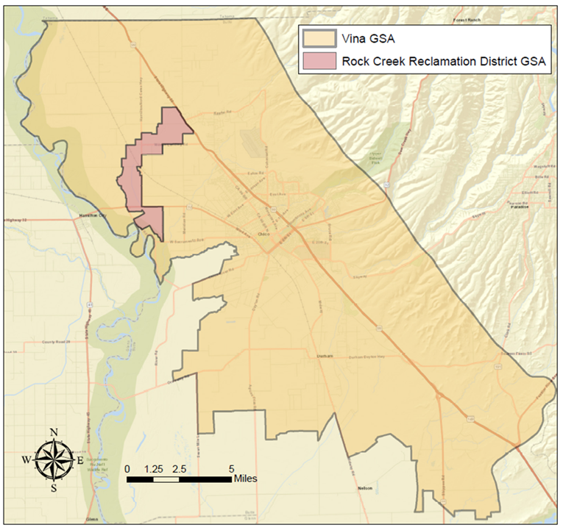

Groundwater Sustainability Plan Status
Vina Subbasin
January 13, 2021

Slide 2
Groundwater Sustainability Plan Status
Groundwater Sustainability Plan
1. Administrative Information
  §354.4. General Information
  §354.6. Agency Information
  §354.8. Description of Plan Area
  §354.10. Notice & Communication
2. Basin Setting
  §354.14. Hydrogeologic Conceptual Model
  §354.16. Groundwater Conditions
  §354.18. Water Budget
  §354.20. Management Areas
3. Sustainable Management Criteria
  §354.24. Sustainability Goal
  §354.26. Undesirable Results
  §354.28. Minimum Thresholds
  §354.30. Measurable Objectives
4. Monitoring Networks
  §354.34. Monitoring Network
  §354.36. Representative Monitoring
  §354.38. Assessment & Improvement
  §354.40. Reporting Monitoring Data to the Department
5. Projects and Management Actions
  §354.44. Projects & Management Actions

Slide 3
Groundwater Sustainability Plan Status
Schedule
  Vina Groundwater Sustainability Plan (version 1)
  Basin Setting Chapter – draft completed
  January to June 2021 (6 months)
    Primary emphasis on specific chapters
          Sustainable Management Criteria
          Representative Monitoring Network
          Interbasin Coordination
          Projects and Management Actions
          Implementation Cost and Funding Options

Slide 4
Groundwater Sustainability Plan Status
Schedule
January 13, 2021
    Draft Sustainable Management Criteria Methodology
    Representative Monitoring Sites
    Projects and Management Actions
    Interbasin Coordination Update
  Provide Direction as Appropriate

Slide 5
Groundwater Sustainability Plan Status
Schedule
    February 10, 2021
    Sustainable Management Criteria Draft Document
      30 day public comment period
      Vina GSA Board Workshop
March 2021
  Representative Monitoring Network Draft Document
    30 day public comment period

Slide 6
Groundwater Sustainability Plan Status
Schedule
    April – May 2021
    Recommendations from the SHAC on draft
      Sustainable Management Criteria
      Projects and Management Actions including costs and funding options
      Representative Monitoring Network
      Data Gaps
      Interbasin Coordination

Slide 7
Groundwater Sustainability Plan Status
Schedule
June 2021
  Projects and Management Actions Draft Document
    30 day public comment period
      Interbasin Coordination Report
    July 2021
      Review the Status of Groundwater Sustainability Plan chapters
      Implementation Chapter Draft Document
        30 day public review

Slide 8
Groundwater Sustainability Plan Status
Schedule
August 2021
  Review the Draft Vina GSP
September 2021
  Complete Draft Vina GSP
  60 day public comment period
November – December 2021
  Board Hearings and Adoption
Implementation …

Slide 9
Groundwater Sustainability Plan Status
Draft Sustainable Management Criteria
Methodology

Slide 10
Groundwater Sustainability Plan Status
Sustainable Management Criteria
Sustainability Goal
Describes the objective for management of the basin
Sustainability is demonstrated by the avoidance of Undesirables Results for the six sustainability indicators
Measures that will be taken to manage the basin (projects and management actions)
How those measures will lead to sustainability
No Undesirable Results
Occurring
Basin operating within its
Sustainable Yield
Sustainability Goal is being
Achieved
If
Then
And

Slide 11
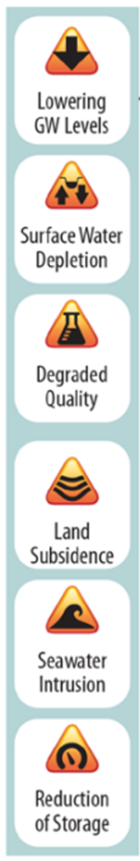
Groundwater Sustainability Plan Status
Sustainable Management Criteria
Sustainable groundwater management is defined as the management and use of groundwater that can be maintained without causing an Undesirable Result from sustainability indicators.
Undesirable Results as defined in SGMA are:
    Persistent lowering of groundwater levels
    Significant and unreasonable reductions in groundwater storage
    Significant and unreasonable saltwater intrusion
    Significant and unreasonable degradation of water quality
    Significant and unreasonable land subsidence
    Surface water depletion having significant and unreasonable effects on beneficial uses
“Significant and unreasonable” is determined by the local GSA through a public process

Slide 12
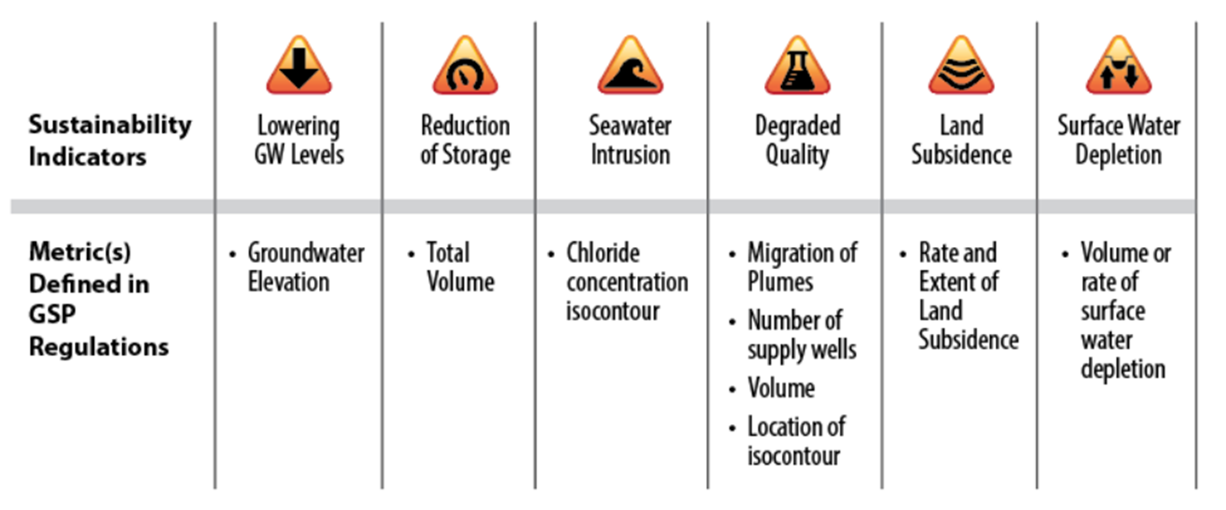

Groundwater Sustainability Plan Status
Sustainable Management Criteria
  Sustainability Indicators
  Beneficial uses & users:
  Agricultural groundwater users
  Domestic well users
  Municipal water systems
  Public water systems
  Land use agencies
  Environmental Users
  Surface water users
  California Native American Tribes
  Federal lands
  Disadvantaged Communities
    Sustainability = Avoidance of Undesirable Results from Sustainability Indicators

Slide 13


Groundwater Sustainability Plan Status
Sustainable Management Criteria
Undesirable Results and Minimum Thresholds
A Minimum Threshold is set at the point of where an Undesirable Result would occur
Setting the Minimum Threshold must consider and describe:
  The factor and causes leading to an Undesirable Result
  The effects of the Undesirable Result on beneficial uses and users of groundwater
Operational flexibility of the basin through Measurable Objectives

Slide 14
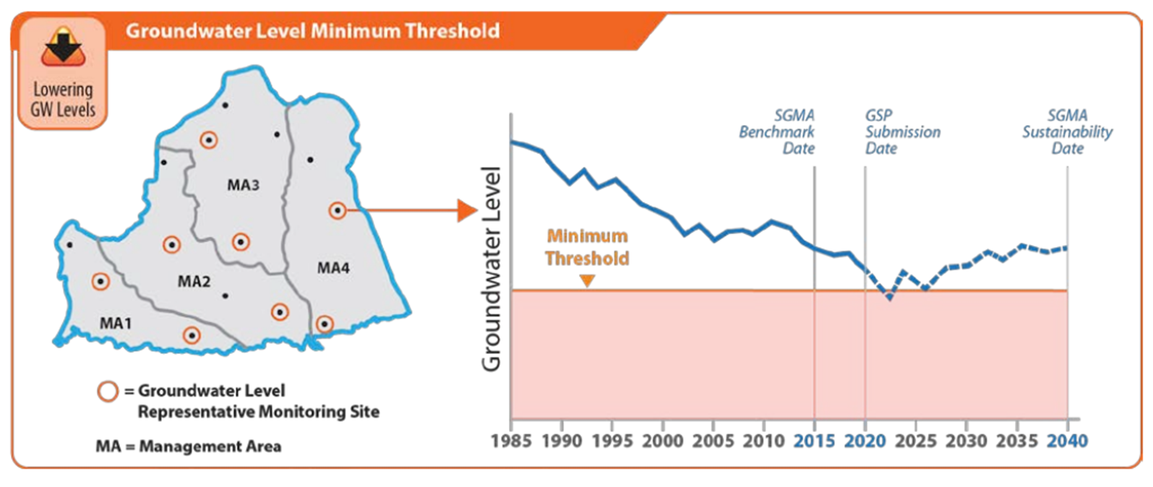
Groundwater Sustainability Plan Status
Sustainable Management Criteria

Slide 15
Groundwater Sustainability Plan Status
Sustainable Management Criteria
Measurable Objectives
A quantitative target that will achieve the sustainability goal within 20 years.
Operational flexibility between the minimum threshold and measurable objective that will accommodate most droughts, climate change, groundwater management activities and uncertainty
Should achieve 5-year interim milestones from representative monitoring site data
Modifications may be necessary if interim milestones are not met

Slide 16
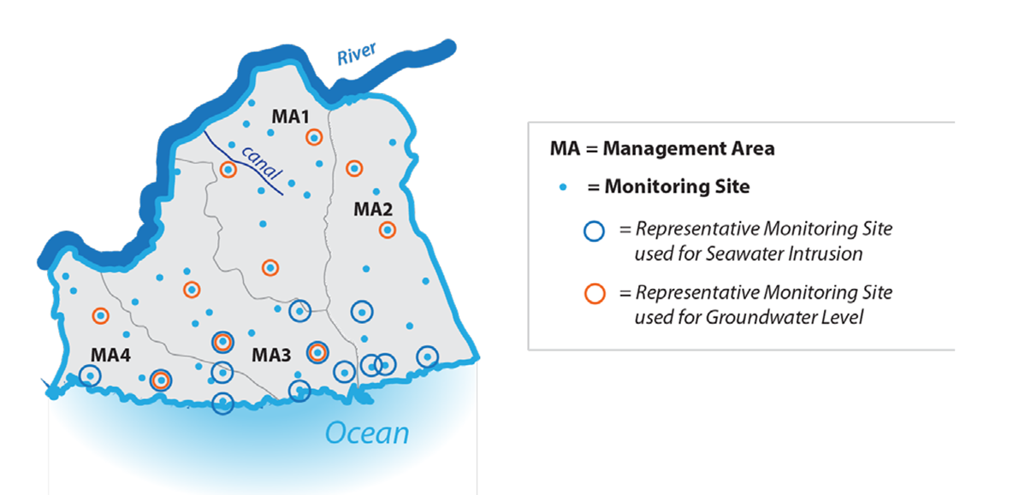
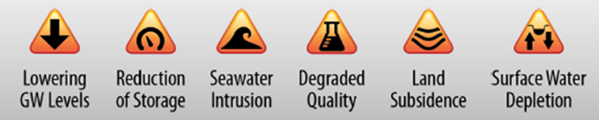
Groundwater Sustainability Plan Status
Representative Monitoring Sites
Compliance through monitoring
not modeling
Subset of the monitoring network
Quantitative measure indicating
whether minimum thresholds,
measurable objectives and
interim milestones are being met
Measures one or more
sustainability indicator

Slide 17
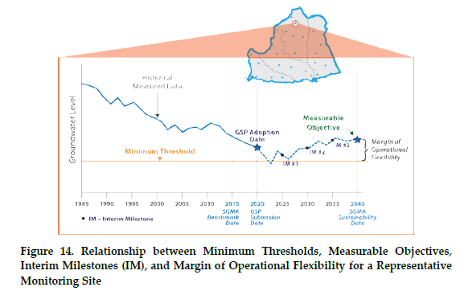
Groundwater Sustainability Plan Status
Sustainable Management Criteria
Measurable Objectives
“Best Management Practice 6:
Sustainable Management Criteria” (DWR)

Slide 18
Groundwater Sustainability Plan Status
Sustainable Management Criteria
Schedule
February 10, 2020 – Vina GSA Board Workshop – SMCs
February 16, 2020 – Start of 30-Day Public Review of SMCs
March 16, 2020 – Discuss SMC Public Comments

Slide 19
Groundwater Sustainability Plan Status
Sustainable Management Criteria
Sustainable Management Criteria Strawman

Slide 20
Groundwater Sustainability Plan Status
Sustainable Management Criteria
Strawman Process Presented to SHAC
Discussed potential wording and quantitative measures to include in the sustainable management criteria
Discussed technical background or monitoring implications related to each sustainable management criteria definition as necessary
Considered how or whether criteria may differ between areas
Discussed and identified specific analysis or further refinement that would be necessary to prepare a draft Sustainable Management Criteria section for approval and incorporation into the Draft Groundwater Sustainability Plan

Slide 21
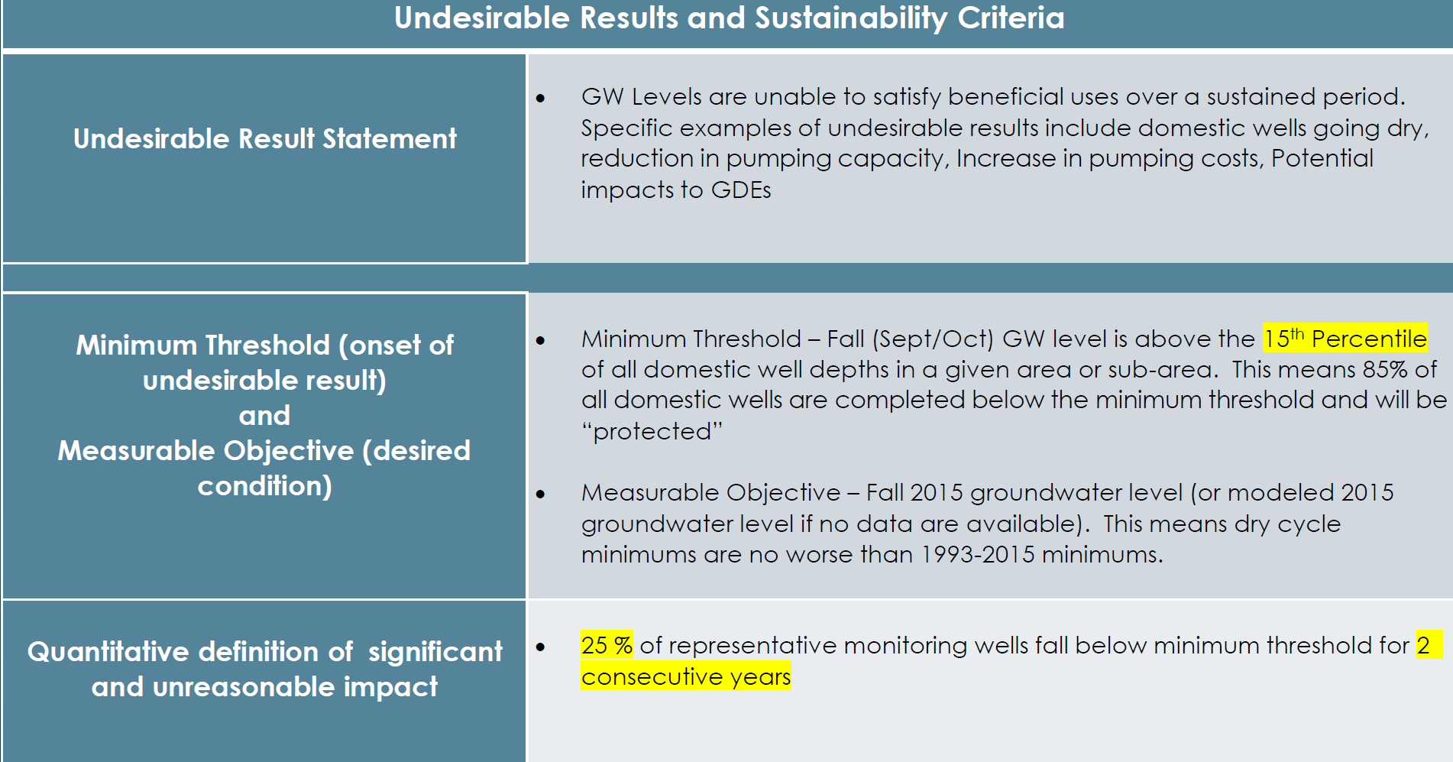
Groundwater Sustainability Plan Status
Sustainable Management Criteria
Chronic Lowering of Groundwater Levels

Slide 22
Groundwater Sustainability Plan Status
Sustainable Management Criteria
Chronic Lowering of Groundwater Levels

Slide 23
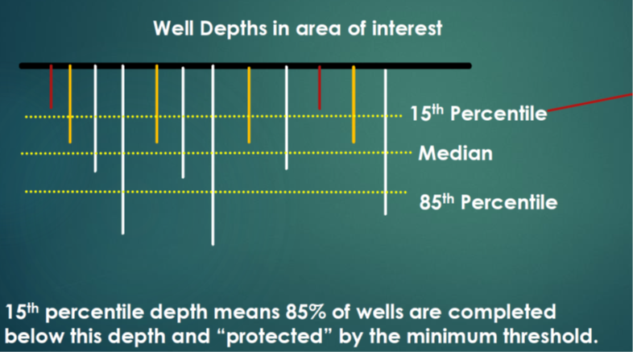
Groundwater Sustainability Plan Status
Sustainable Management Criteria
Box and Whiskers plot is a rank-order analysis of all well depths

Slide 24
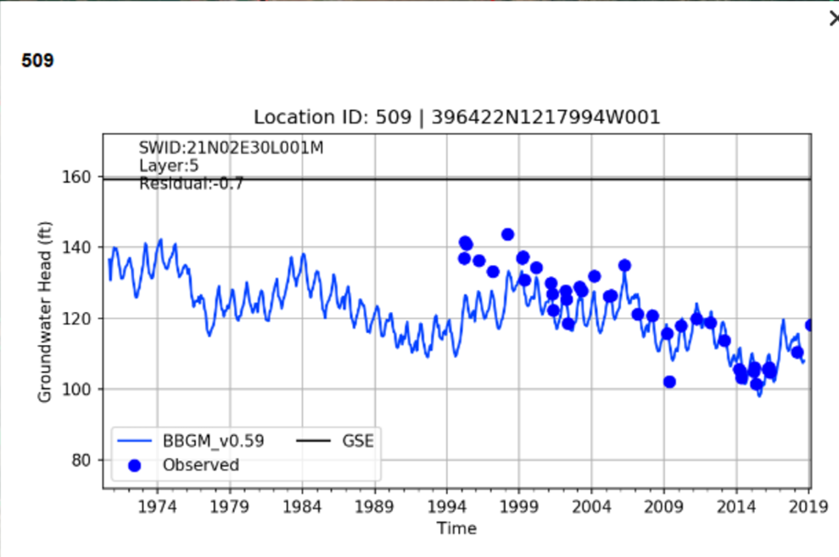
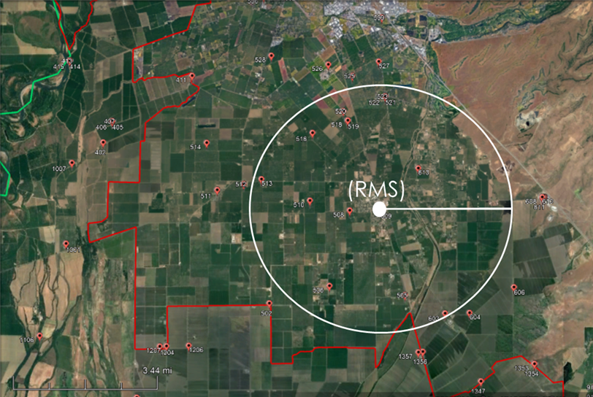
Groundwater Sustainability Plan Status
Sustainable Management Criteria
Chronic Lowering of Groundwater Levels
Summary : Domestic well depths set the Minimum Threshold
Chronic Lowering of Groundwater Levels
Min Threshold

Slide 25
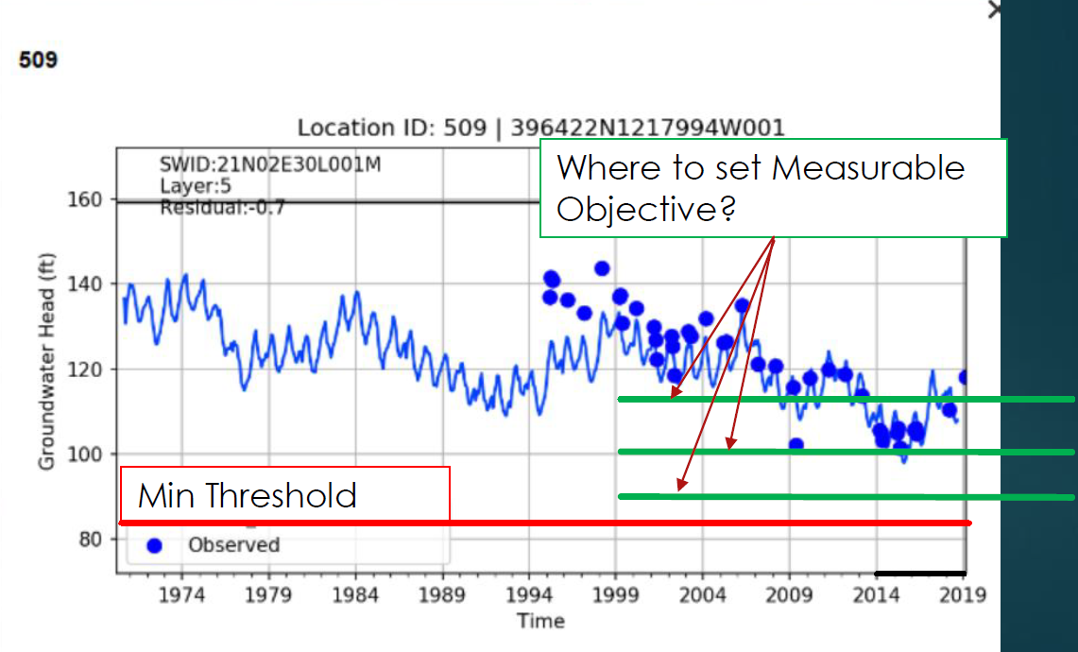
Groundwater Sustainability Plan Status
Sustainable Management Criteria
Chronic Lowering of Groundwater Levels
Establishing a Measurable Objective with periodic water level decline
Chronic Lowering of Groundwater Levels

Slide 26
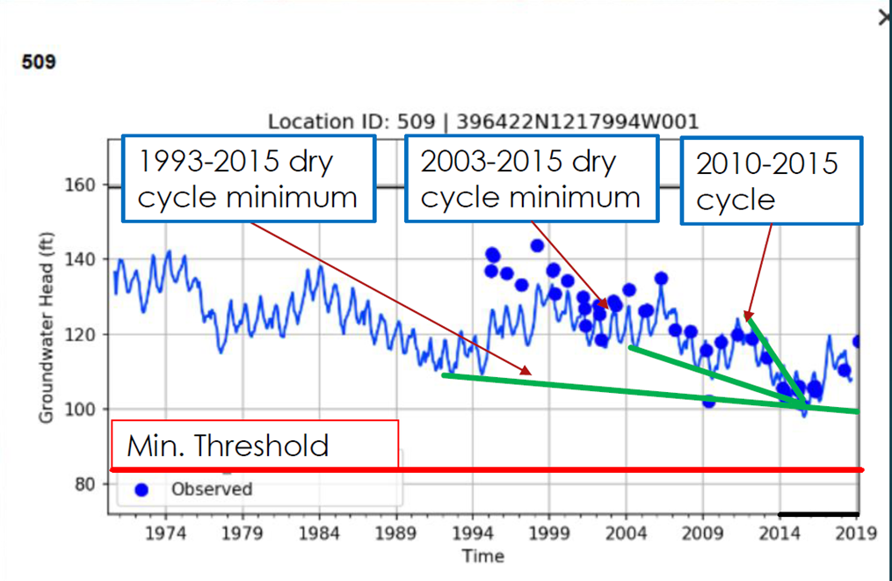
Groundwater Sustainability Plan Status
Sustainable Management Criteria
Chronic Lowering of Groundwater Levels
Selecting a Measurable Objective based on existing data: 2015 vs historic trend
Chronic Lowering of Groundwater Levels

Slide 27
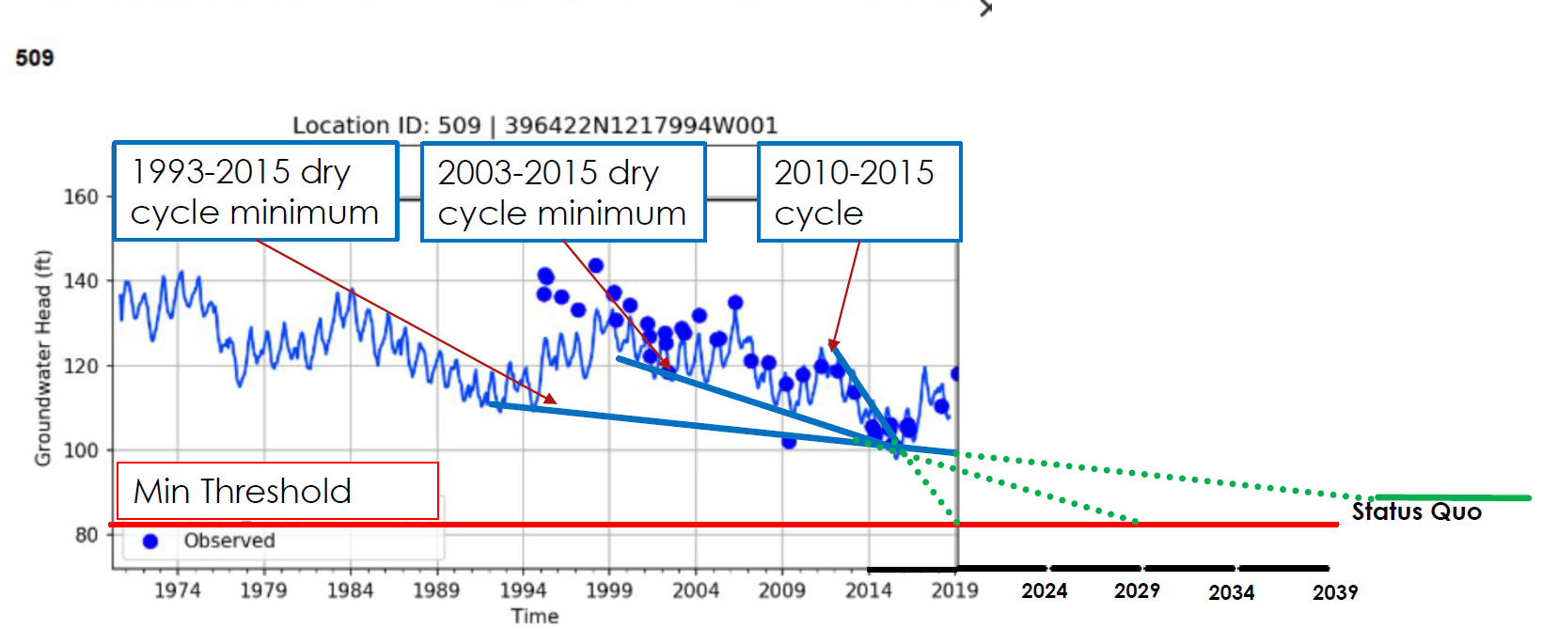
Groundwater Sustainability Plan Status
Sustainable Management Criteria
Chronic Lowering of Groundwater Levels
Simple projection of historic trend
Chronic Lowering of Groundwater Levels

Slide 28
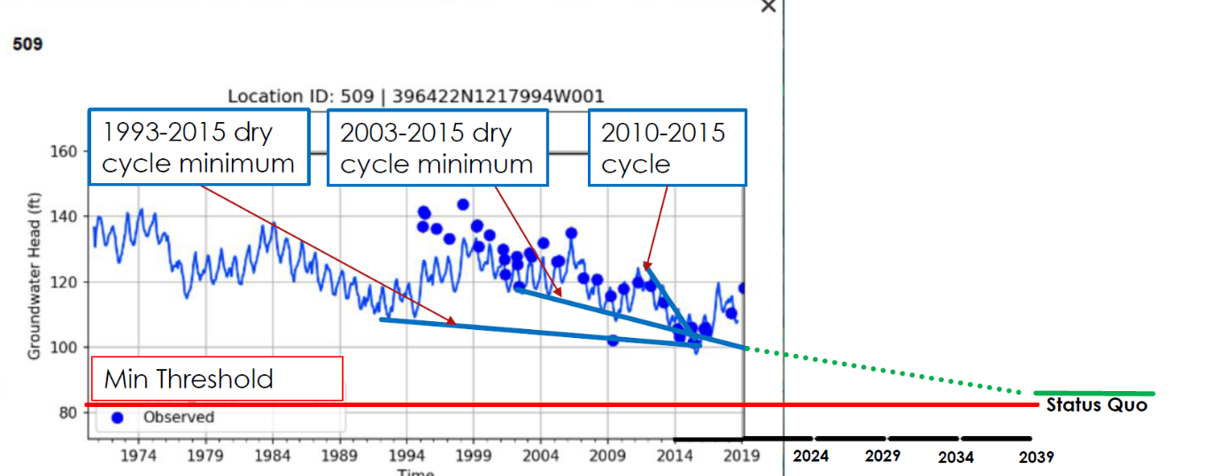
Groundwater Sustainability Plan Status
Sustainable Management Criteria
Chronic Lowering of Groundwater Levels
Simple Projection of historic trend

Slide 29
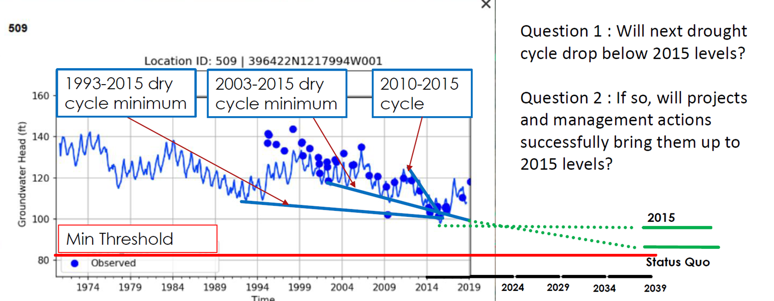
Groundwater Sustainability Plan Status
Sustainable Management Criteria
Chronic Lowering of Groundwater Levels
Simple Projection of historic trend
Chronic Lowering of Groundwater Levels

Slide 30
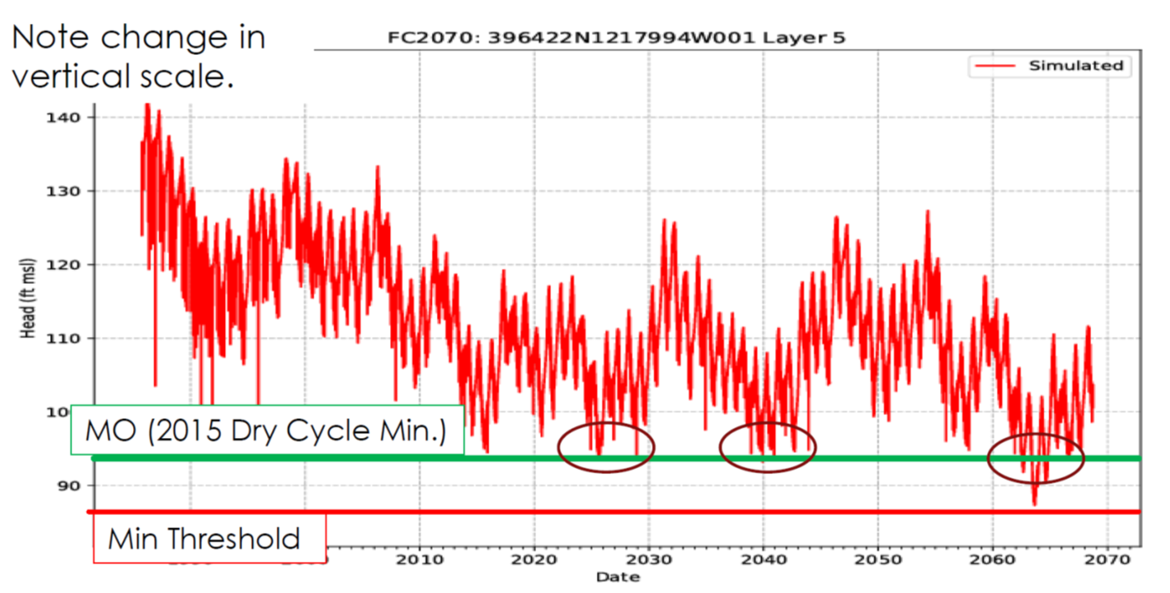
Groundwater Sustainability Plan Status
Sustainable Management Criteria
Chronic Lowering of Groundwater Levels
Model Projection (2020-2070)
Chronic Lowering of Groundwater Levels
Projection based on:
2030 Butte Co. General Plan land use
CalWater 2050 Urban water demands
Historical hydrology wit DWR central tendency for 2070 climate projection

Slide 31
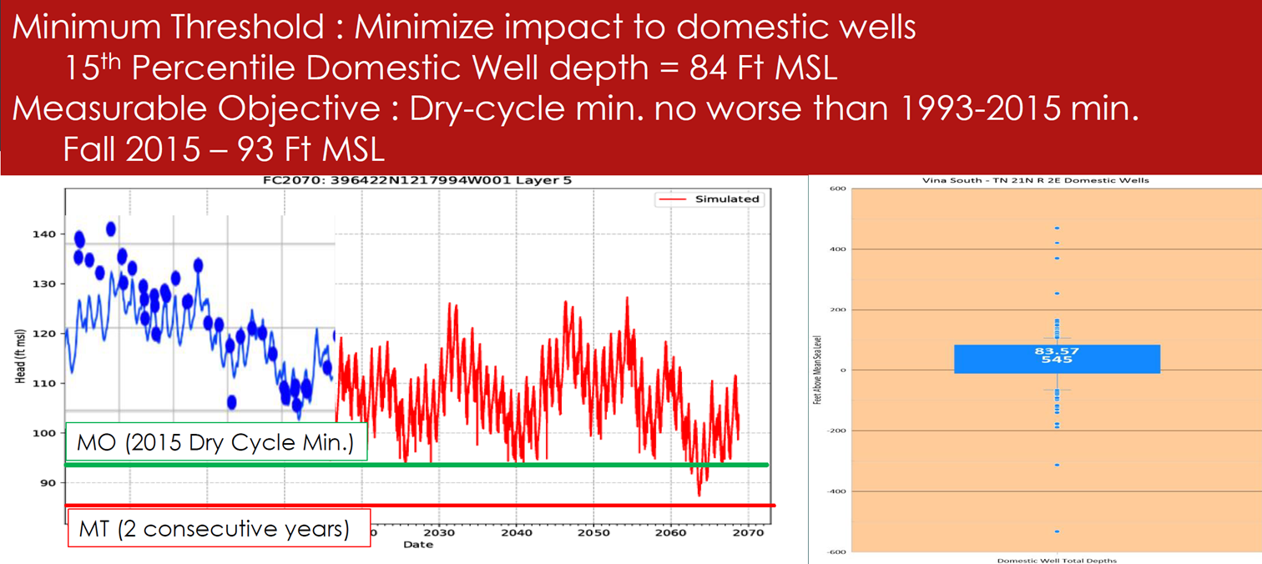
Groundwater Sustainability Plan Status
Sustainable Management Criteria
Chronic Lowering of Groundwater Levels
Summary Example SMC
Chronic Lowering of Groundwater Levels

Slide 32
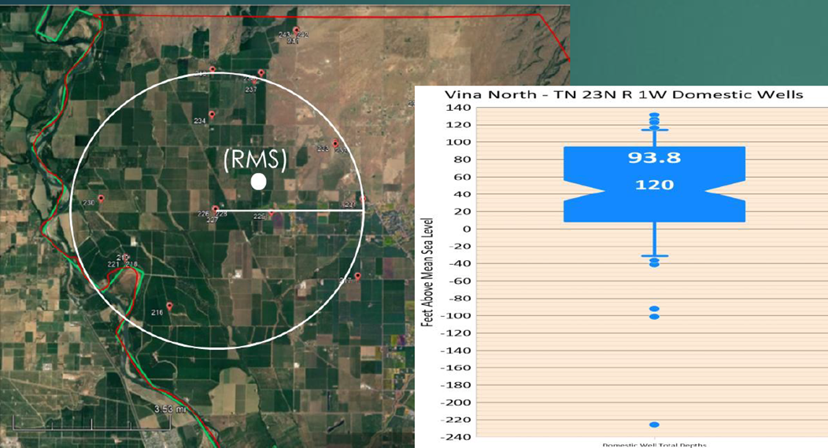
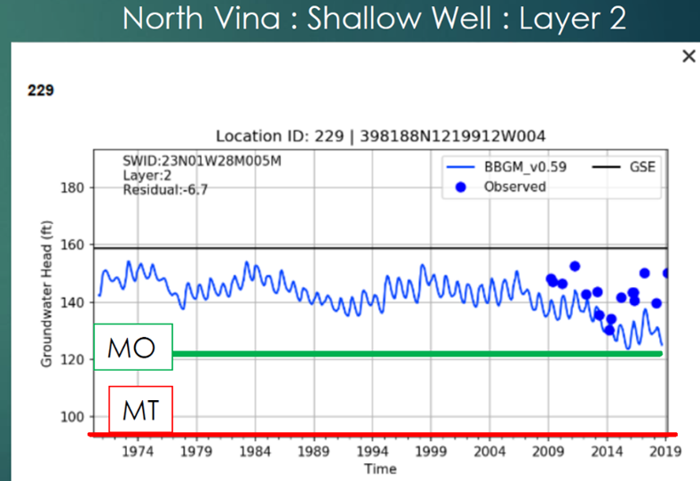
Groundwater Sustainability Plan Status
Sustainable Management Criteria
Chronic Lowering of Groundwater Levels
SMC Process applies to each Representative Monitoring Site (RMS)
Chronic Lowering of Groundwater Levels

Slide 33
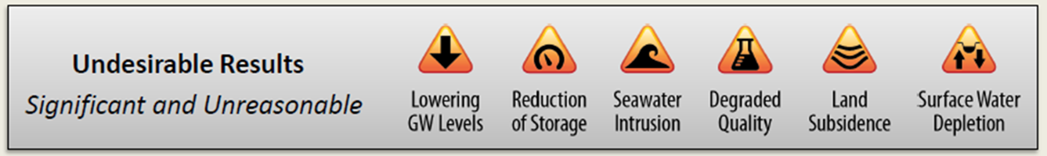
Groundwater Sustainability Plan Status
Sustainable Management Criteria
Reduction in Storage & Subsidence
Sustainable Management Criteria for Groundwater Levels will be a proxy for Reduction in Storage and Subsidence

Slide 34
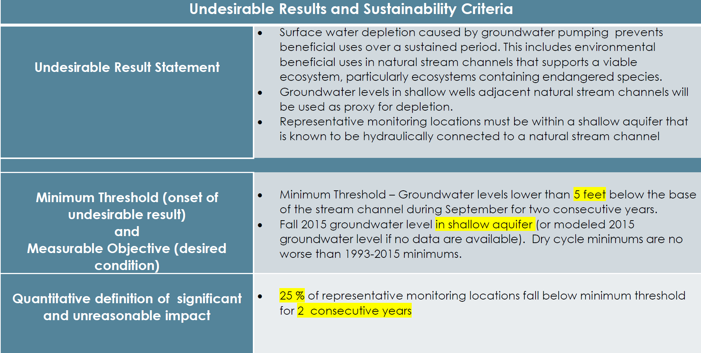
Groundwater Sustainability Plan Status
Sustainable Management Criteria
Depletion of Interconnected Surface Water

Slide 35
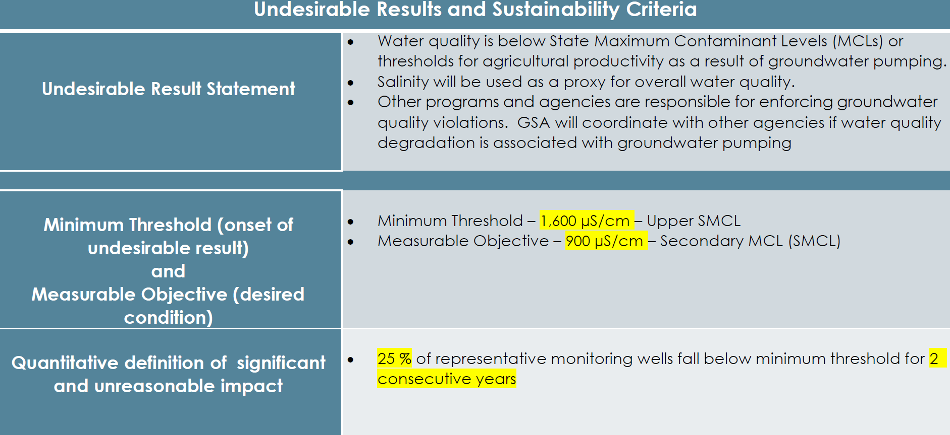
Groundwater Sustainability Plan Status
Sustainable Management Criteria
Degraded Water Quality

Slide 36
Groundwater Sustainability Plan Status
Sustainable Management Criteria
Next Steps
  January 19, 2021 - Presentation and discussion by SHAC of Sustainable Management Criteria and Representative Monitoring Sites
  February 10, 2021 – Public Comment Period (30 days)
  February 19, 2021 – Vina GSA Board Workshop

Slide 37
Groundwater Sustainability Plan Status
Sustainable Management Criteria
Discussion

Slide 38
Groundwater Sustainability Plan Status
Projects and Management Actions

Slide 39
Groundwater Sustainability Plan Status
Projects and Management Actions
A required element of Groundwater Sustainability Plans
Comprise the efforts that will achieve the sustainability goals (Measurable Objectives) established in the Vina GSP

Slide 40
Groundwater Sustainability Plan Status
Projects and Management Actions
Current Status
SHAC continues to discuss of potential Projects and Management Actions
Solicitation of potential Projects and Management Actions for consideration
By spring, a matrix of prioritized potential Projects and Management Actions
    Planned – Projects in this category meet the acceptable criteria, have adequate planning and are scheduled to be completed prior to 2042.
    Potential – Projects in this category meet the acceptable criteria but are in early planning stages, but possibly could be completed by 2042. For example, these projects may have uncertain funding sources or need additional analysis.
    Conceptual – Projects in this category are in early conceptual planning stages and would require significant additional work.

Slide 41
Projects and Management Actions
Projects and Management Actions
Project Name | Project Type | Project Proponent | Measurable Objective Expected to Benefit | Current Status | Time-table (initiation to completion | Estimated Cost | Required Permitting and Regulatory Process | Expected Groundwater Demand Reduction (AF/year) | Planned, Potential, Or Concept | Management Area
Project A | Ag Conservation | TBD | Groundwater levels, Stream |  | TBD | TBD | TBD | TBD | TBD | TBD
Project B | Recharge | TBD | Groundwater levels, Stream |  | TBD | TBD | SWRCB Temporary water right permit | TBD | TBD | TBD
Project C | Recycling | TBD | Groundwater levels, Stream |  | TBD | TBD | NPDES, Regional Board | TBD | TBD | TBD
Project D | New Water Supply | TBD | Groundwater Levels, Stream |  | TBD | TBD | TBD | TBD | TBD | TBD
Project D | Urban Conservation | Vina GSA | Groundwater levels, Stream |  | TBD | TBD | TBD | TBD | TBD | TBD
Project E | Pumping Allocation | TBD | Groundwater Levels, Stream |  | TBD | TBD | TBD | TBD | TBD | TBD
Example

Slide 42
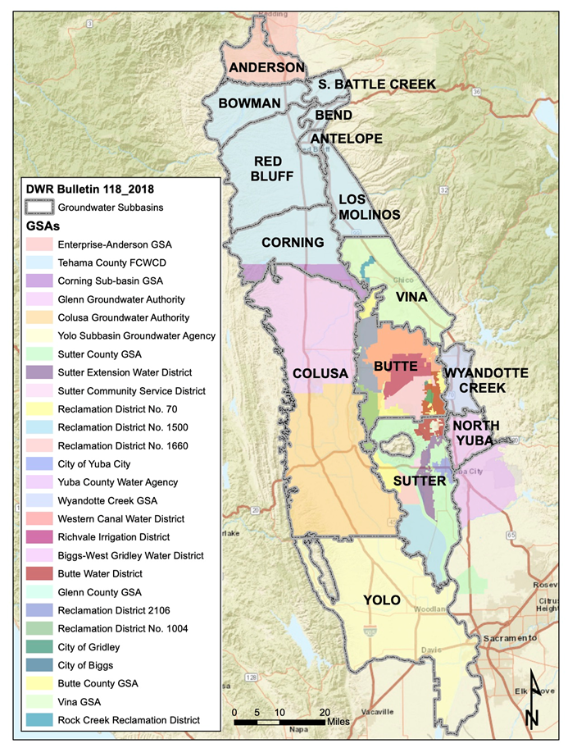
Groundwater Sustainability Plan Status
Northern Sacramento Valley Interbasin Coordination

Slide 43
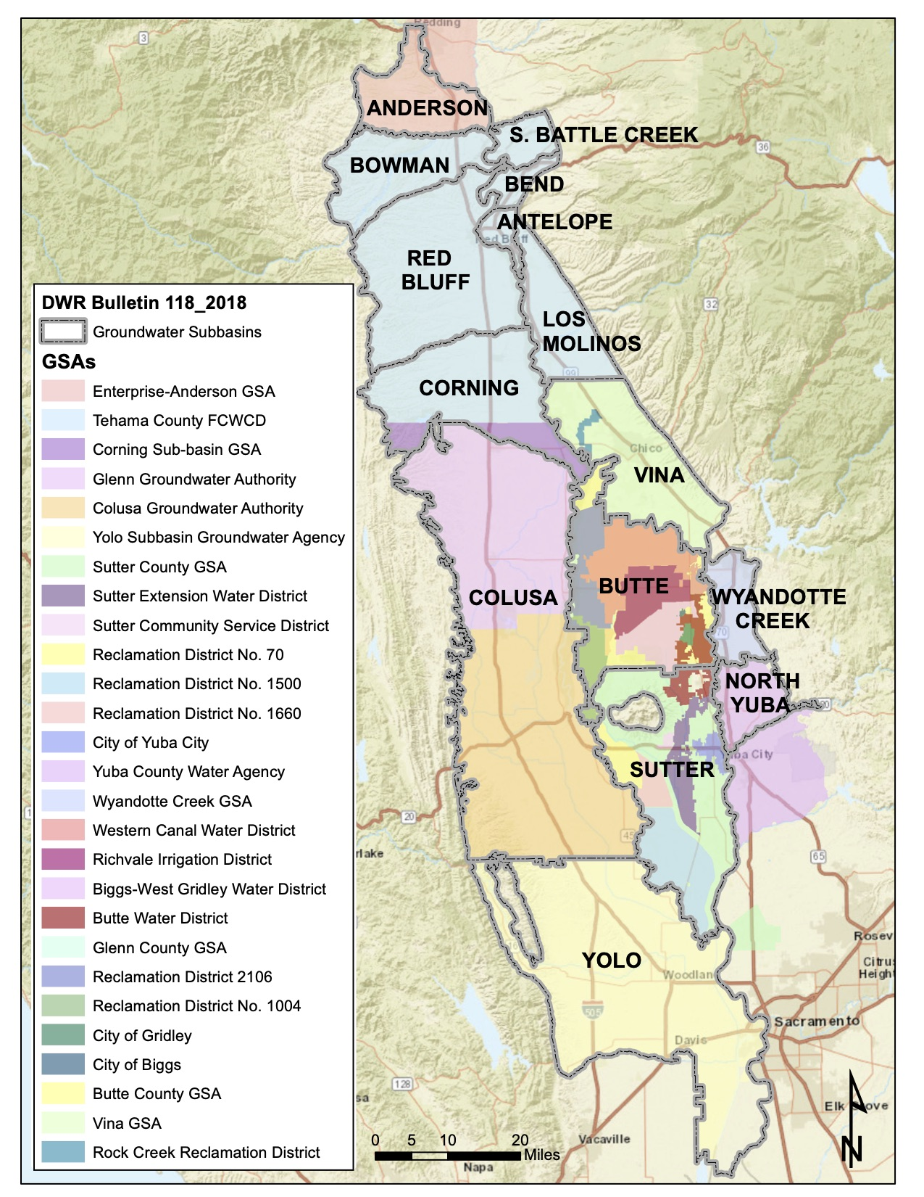

Inter-basin Coordination Efforts | Northern Sacramento Valley
Antelope | Bowman | Butte | Colusa | Corning | Los Molinos| Red Bluff | Vina | Wyandotte Creek Subbasins
Mariana Rivera-Torres
mriveratorres@cbi.org
Antelope | Bowman | Butte | Colusa | Corning | Los Molinos| Red Bluff | Vina | Wyandotte Creek
Notes:
Changed the Title from North to Northern

Slide 44
Groundwater Sustainability Plan Status
Thank You

